Slide 1
Welcome to Coach Ketcham’s Class

Slide 2
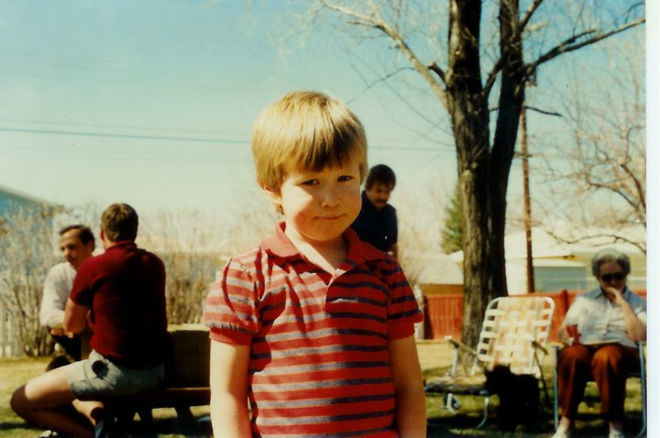
I see we are all excited to be here today.

Slide 3
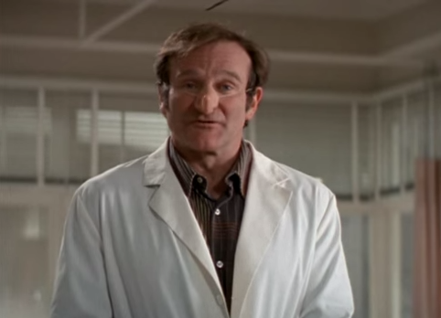
You will have so much fun on the first day of school.

Slide 4
Any other questions

Slide 5
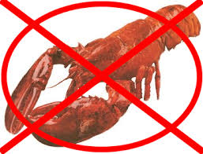
No eating Lobster in class, without sharing with all of us.

Slide 6
Because teachers be like…

Slide 7
and students be like…

Slide 8
We are on the line and the Exchange-o- Gram

Slide 9
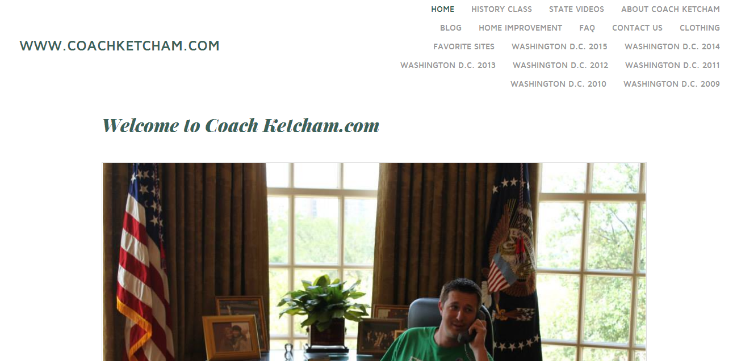
WWW.CoachKetcham.com

Slide 10
CoachKetchamsClass

Slide 11
Homework Free Zone
We value each others time
States

Slide 19
